Slide 1
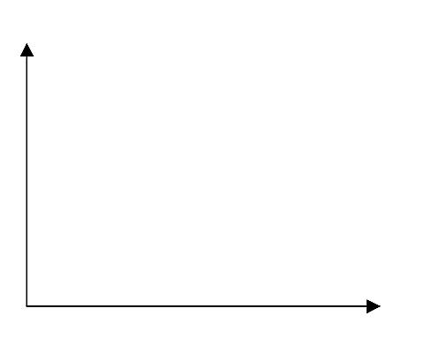
Cost
Cost of Living
Career Advancement
Wish to have children
1 | 2 | 3 | 4 | 5 | 6 | 7 | 8 | 9 | 10
Time(Years)

Slide 2
Marriage
Happiness
Sustainability
Wish to have children
1 | 2 | 3 | 4 | 5 | 6 | 7 | 8 | 9 | 10
Time(Years)

Slide 3
Government Incentives
Number of Incentives
Reception of Success
Wish to have children
1 | 2 | 3 | 4 | 5 | 6 | 7 | 8 | 9 | 10
Time(Years)

